Slide 1
PACIFICA School District Measure O Oversight Committee January 13, 2021

Slide 2
Projects status:
Linda Mar Educational Center Fire Code Project. (bid price $617,540)
The project is currently under construction. Construction completion date is scheduled for April 9th.
Drinking Fountain and Touchless filtered bottle station. (bid price $151,111)
For Sunset Ridge, Vallemar, Cabrillo, LMEC, Ortega, and District office. IBL and Ocean Shore did not choose drinking fountains for their bond project list.
All interior drinking fountains have been completed. The outdoor drinking fountain enclosure is being installed right now. After that’s completed, the outdoor drinking fountain will be installed. Project will be completed by the end of January.

Slide 3
Projects status:
Outdoor Furniture (bid price: $107,570)
For Ocean Shore, IBL, Vallemar, Cabrillo, District Office. The other school sites did not choose outdoor furniture for their bond project list.
Completed on 11/25/2020

Slide 4
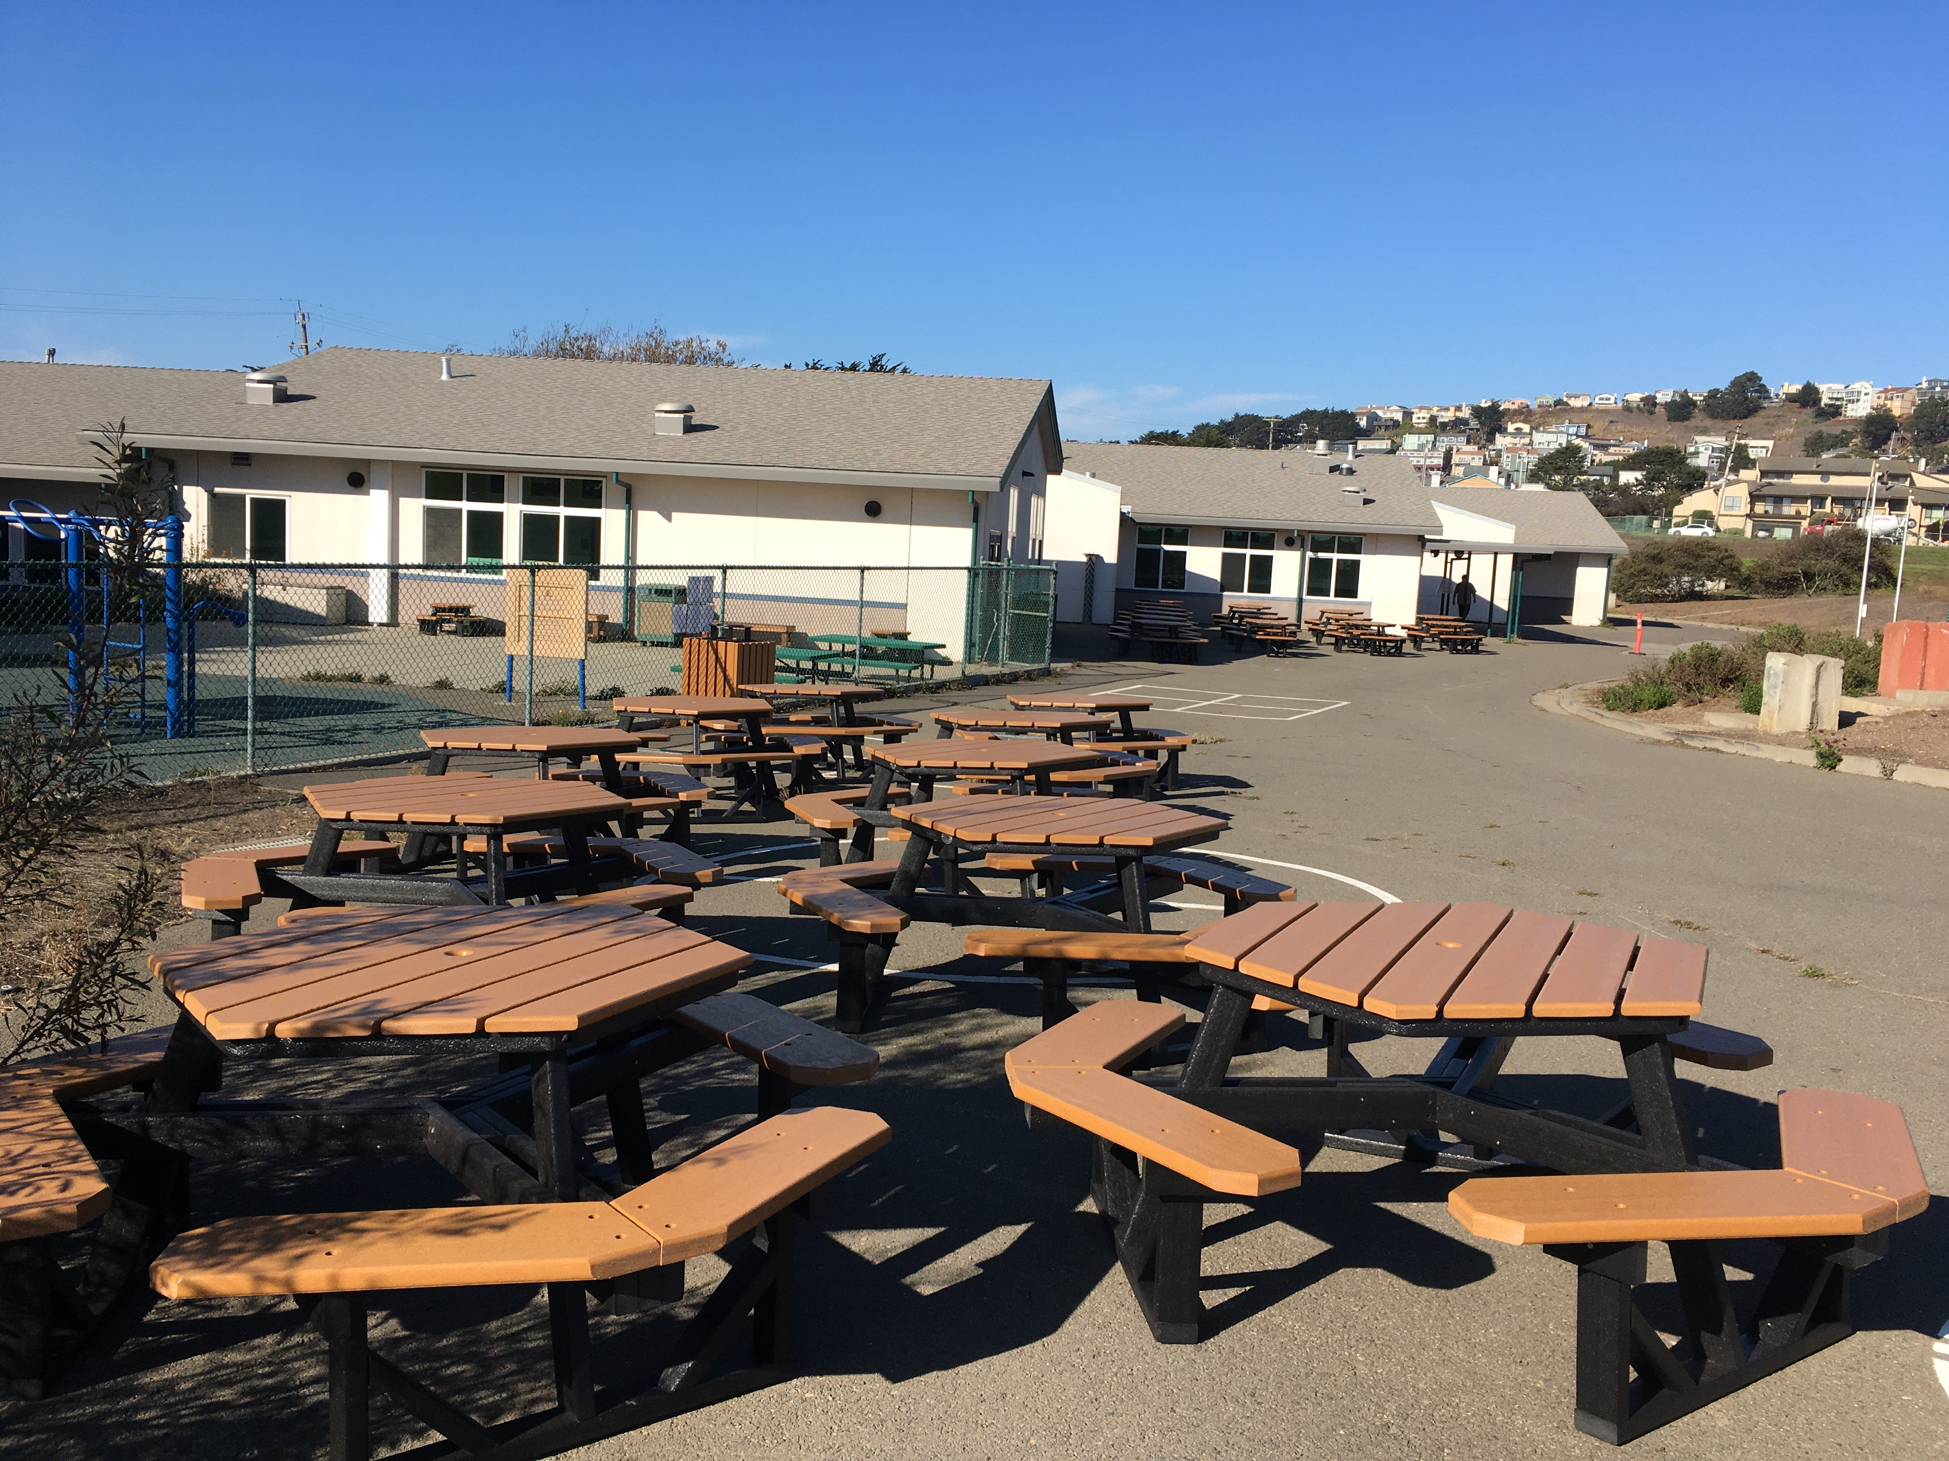
OCEAN SHORE

Slide 5
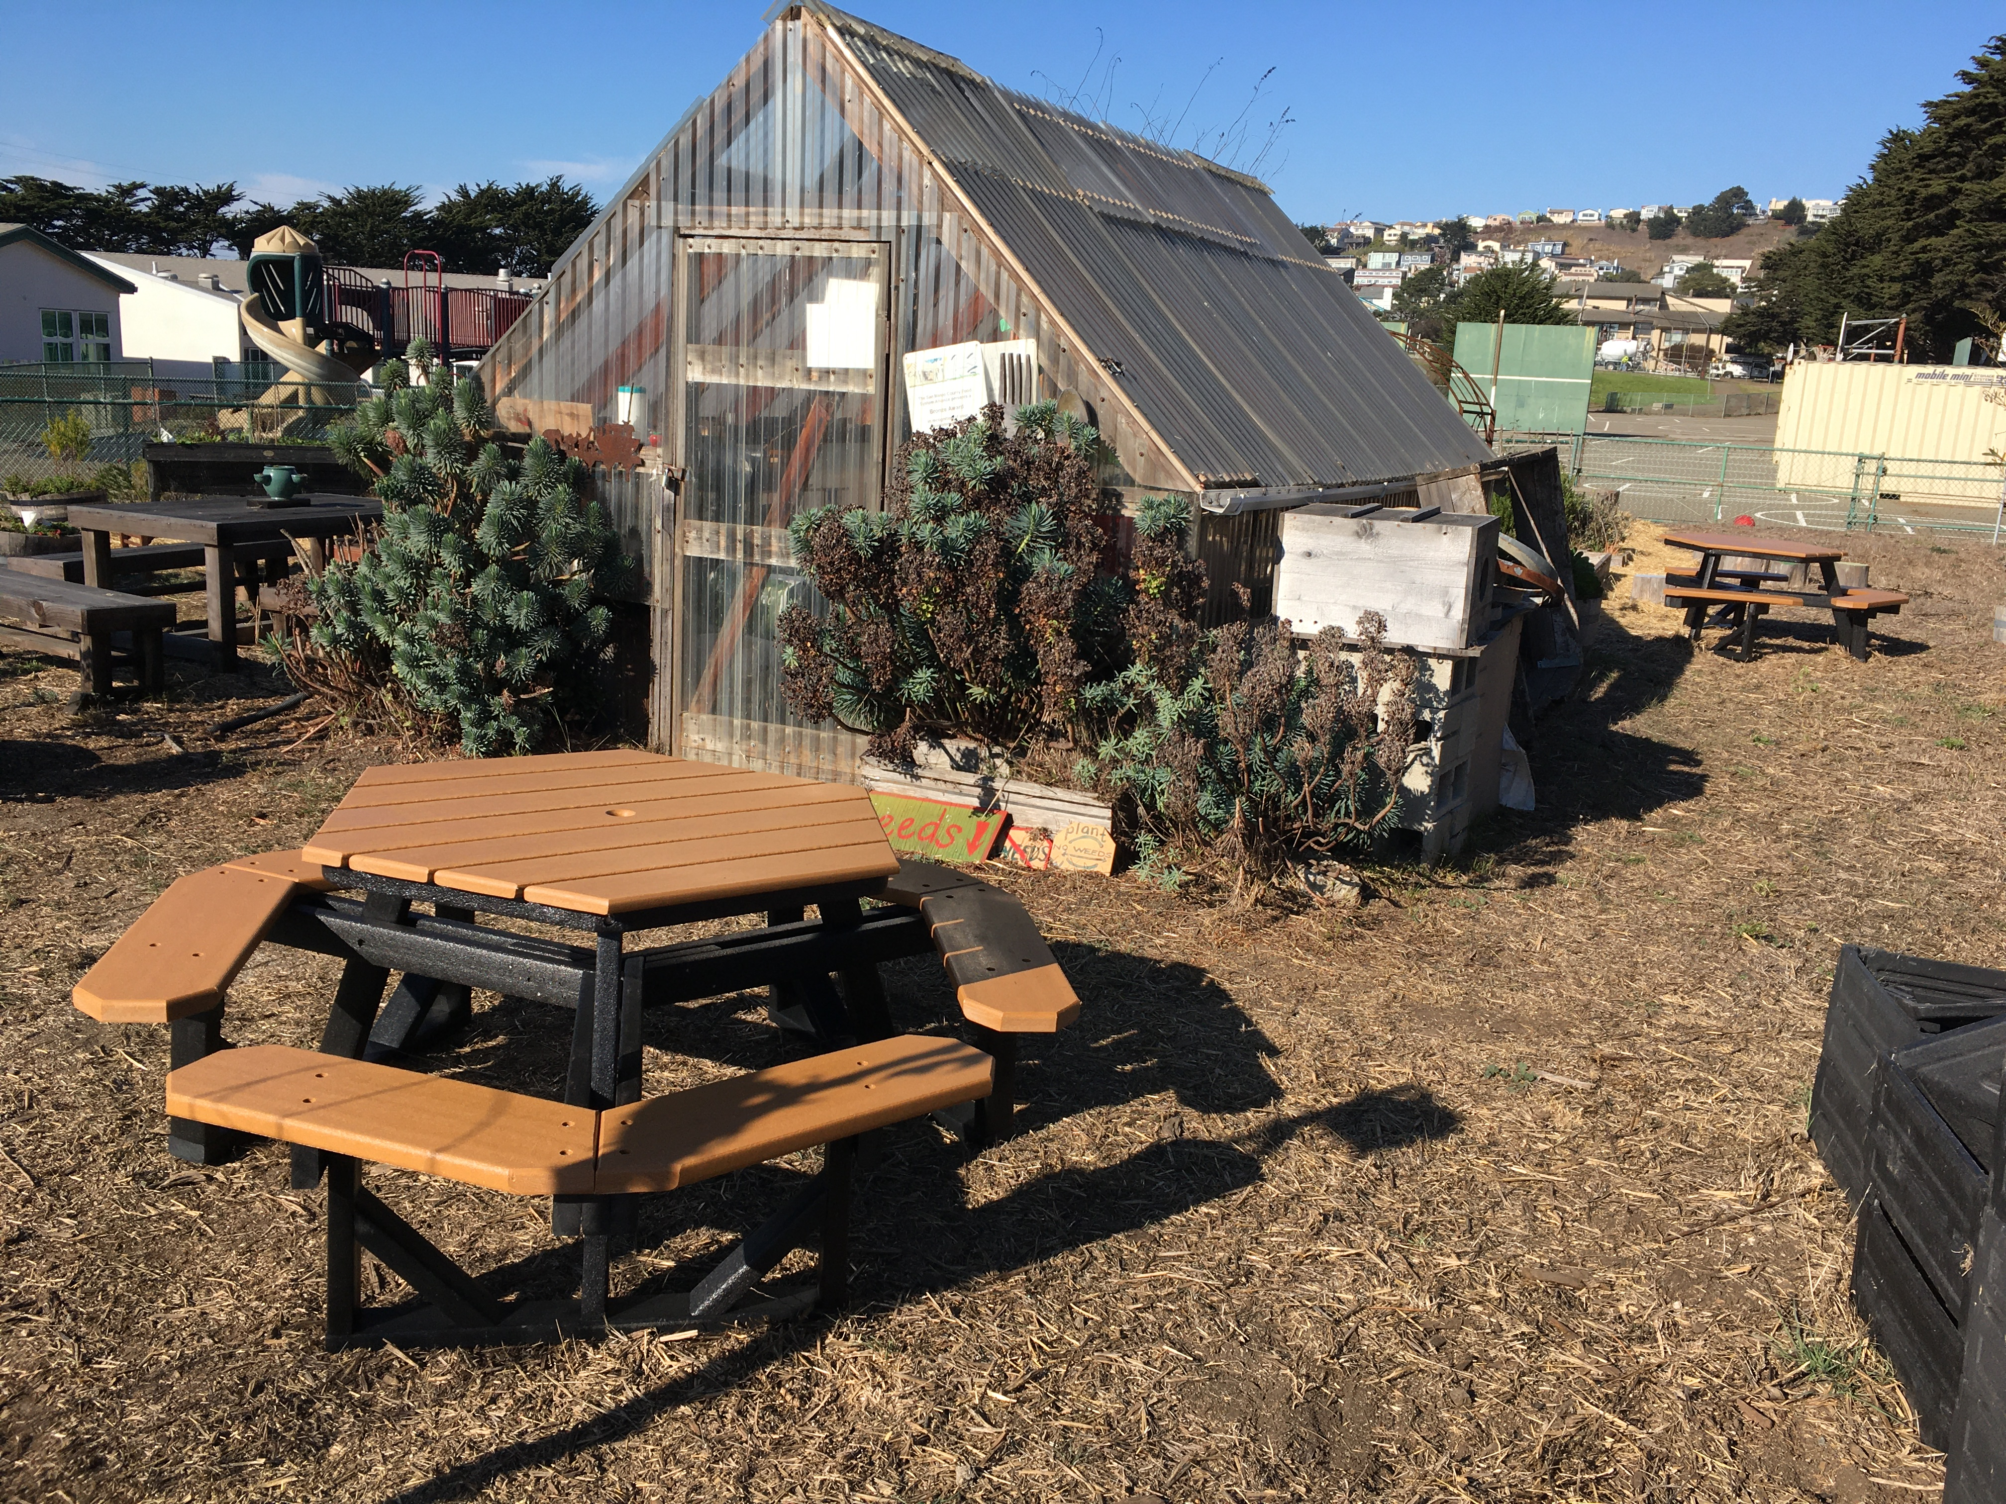
OCEAN SHORE

Slide 6
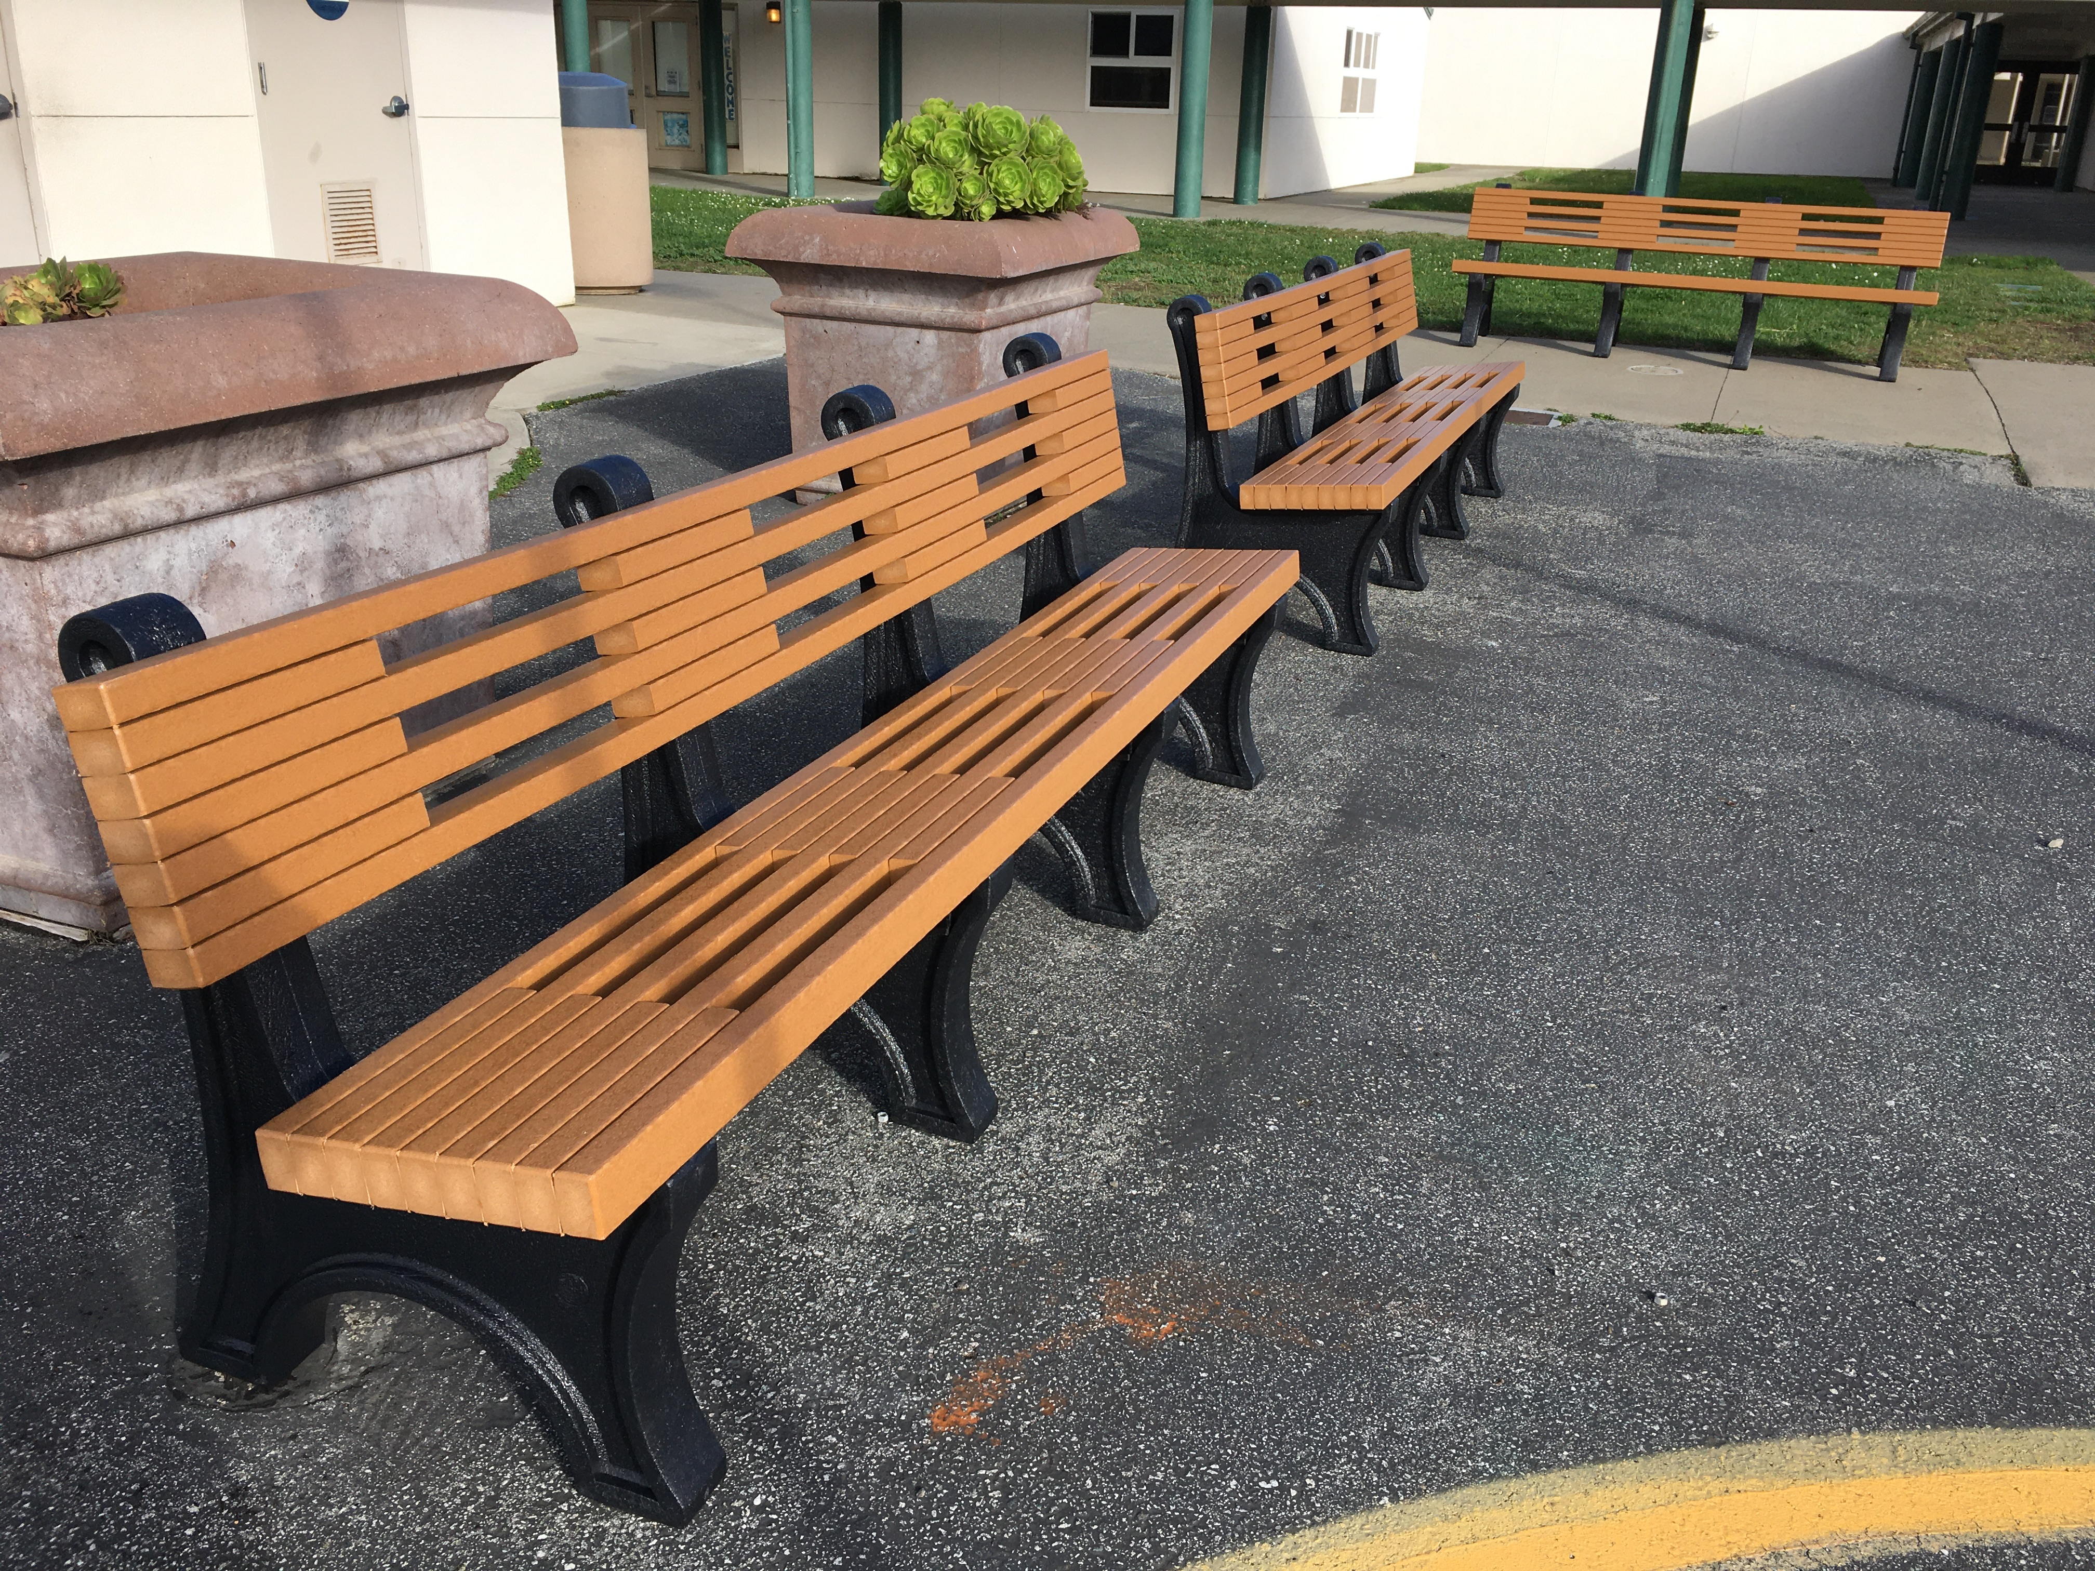
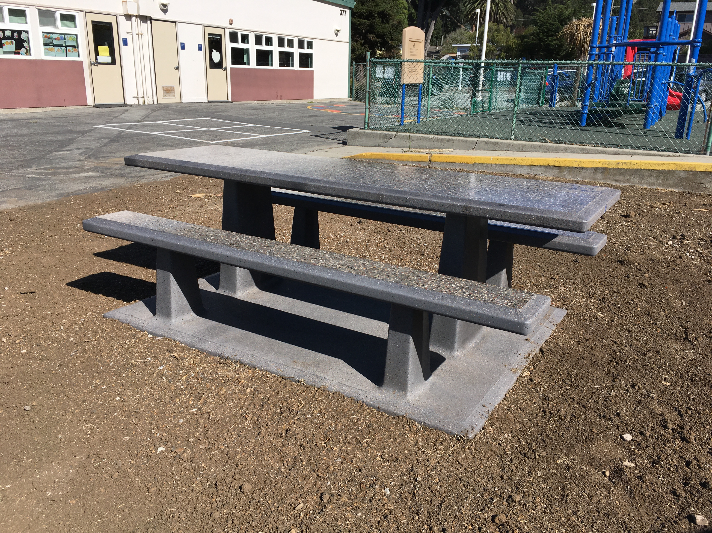
VALLEMAR

Slide 7
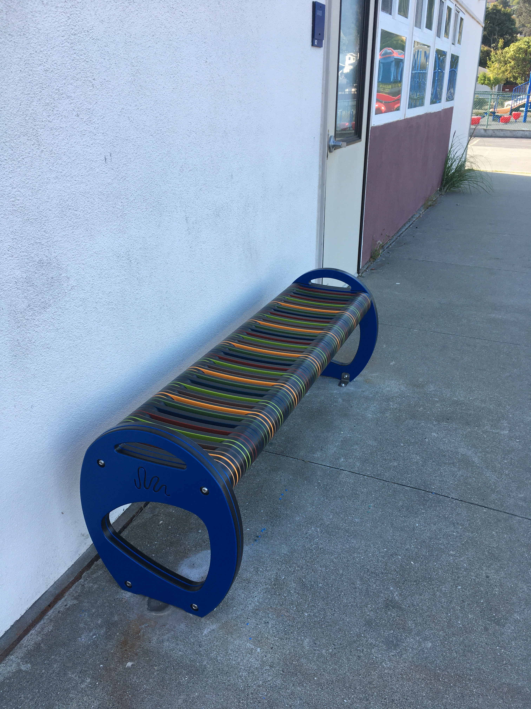
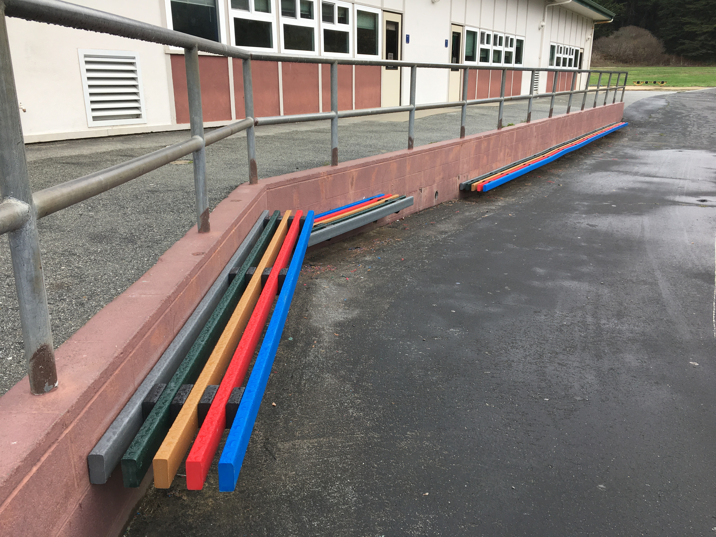
VALLEMAR

Slide 8
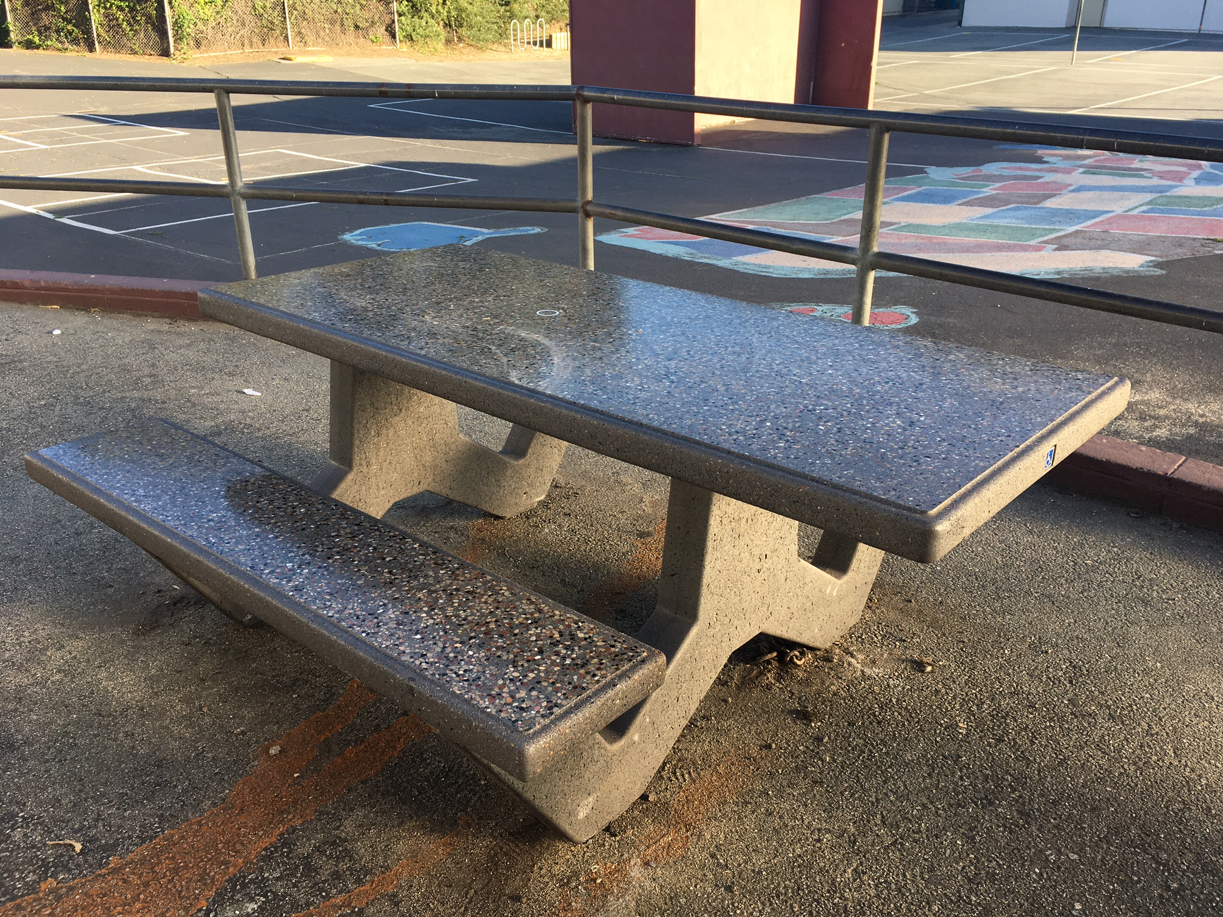
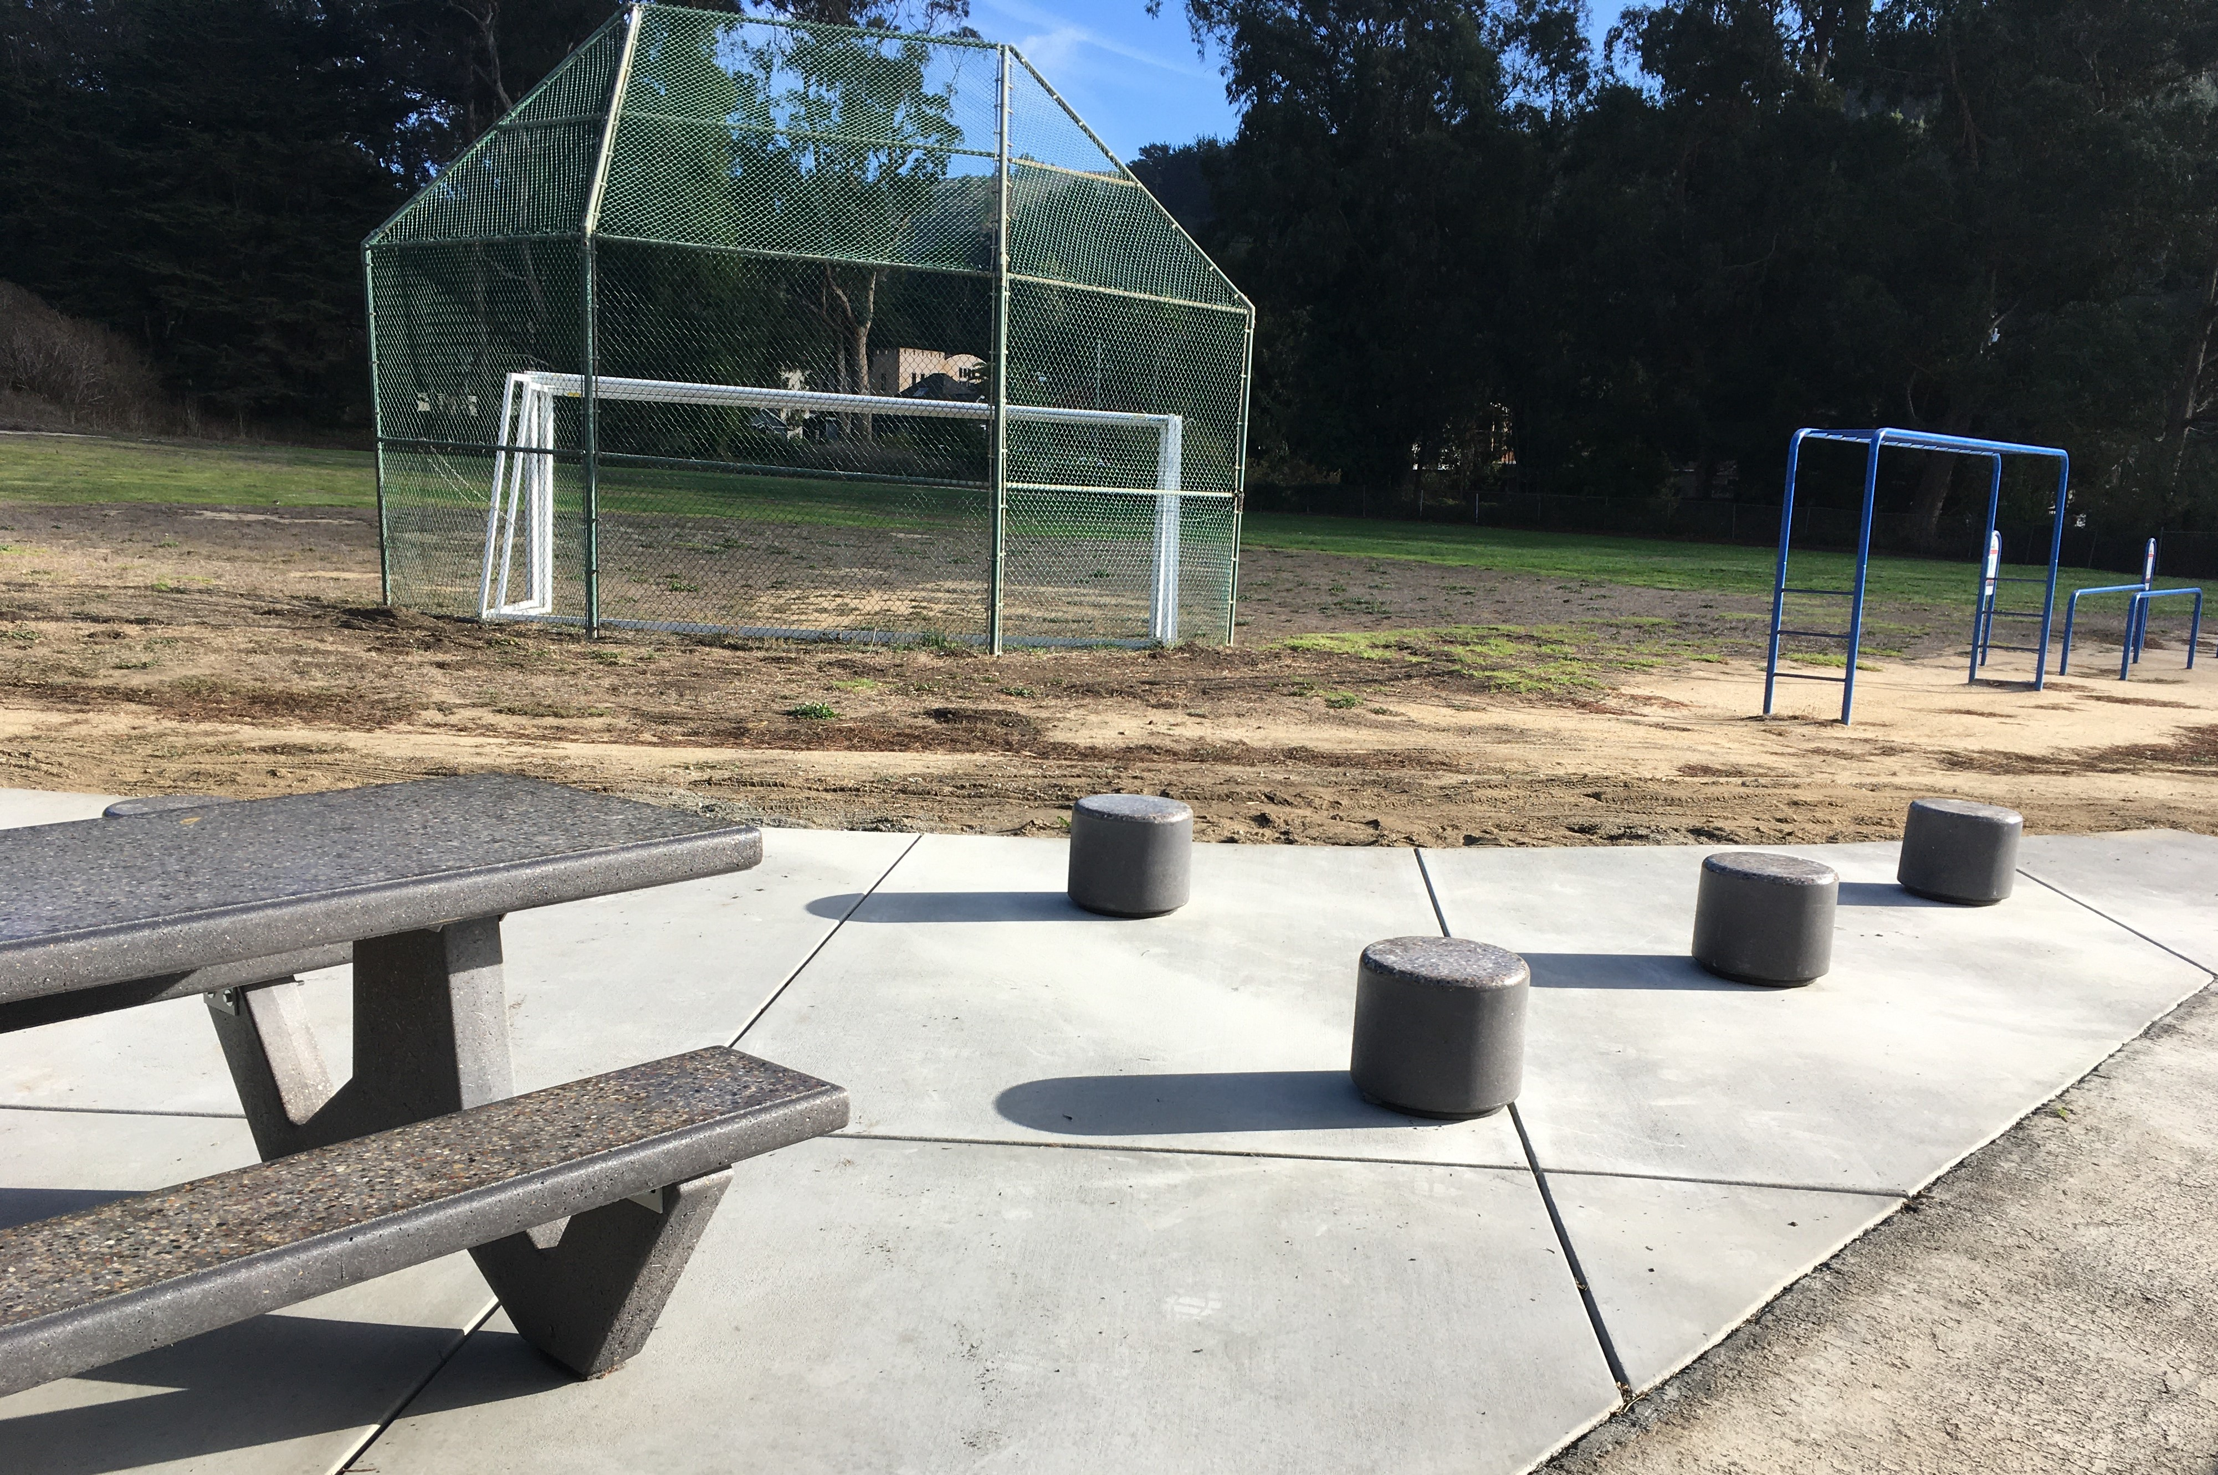
VALLEMAR

Slide 9
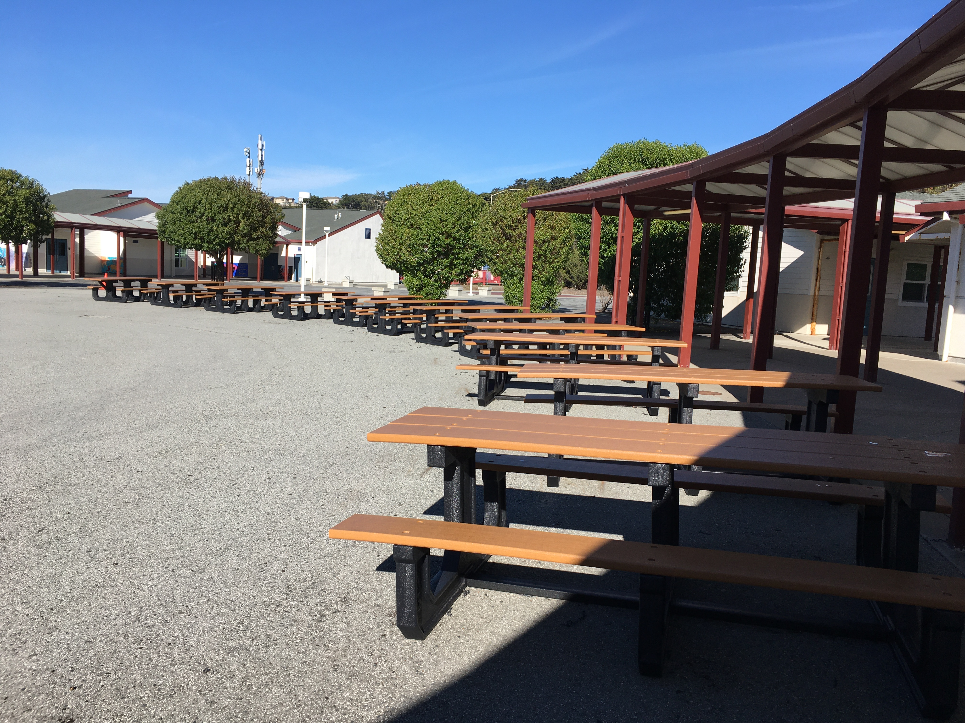
IBL

Slide 10
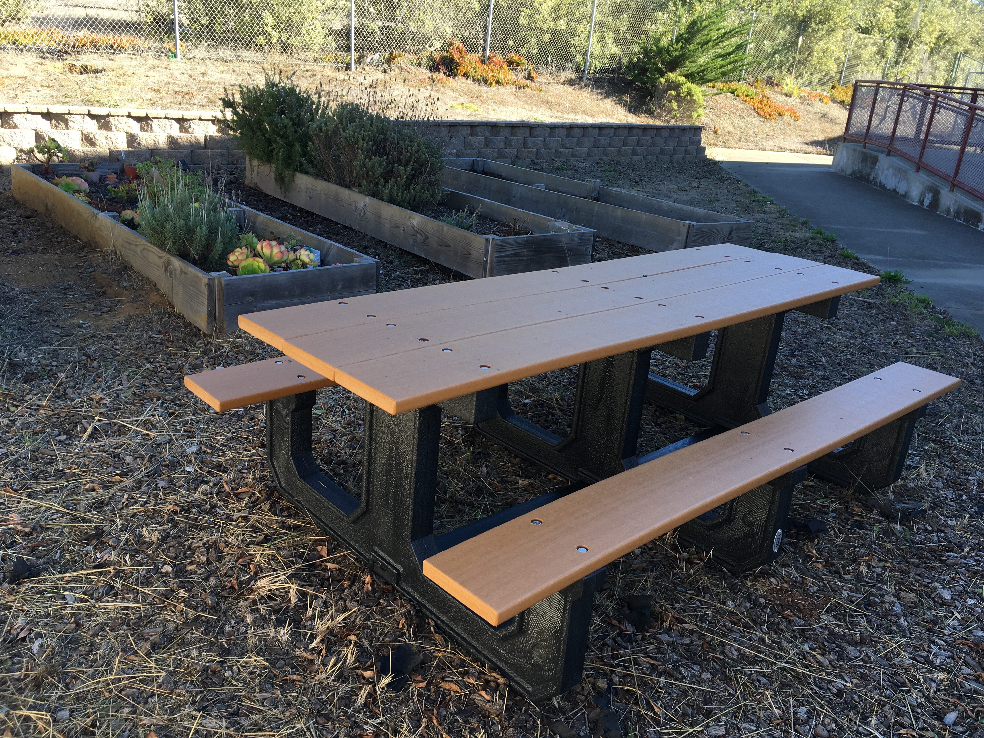
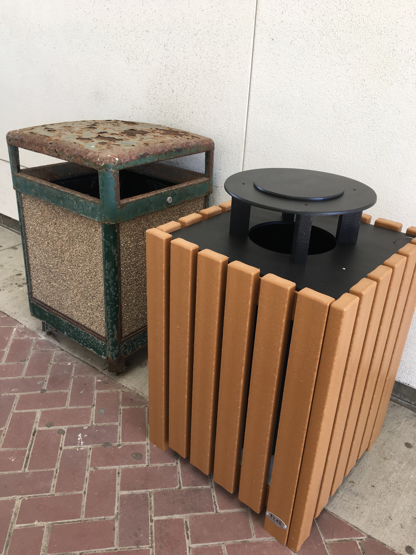
IBL

Slide 11
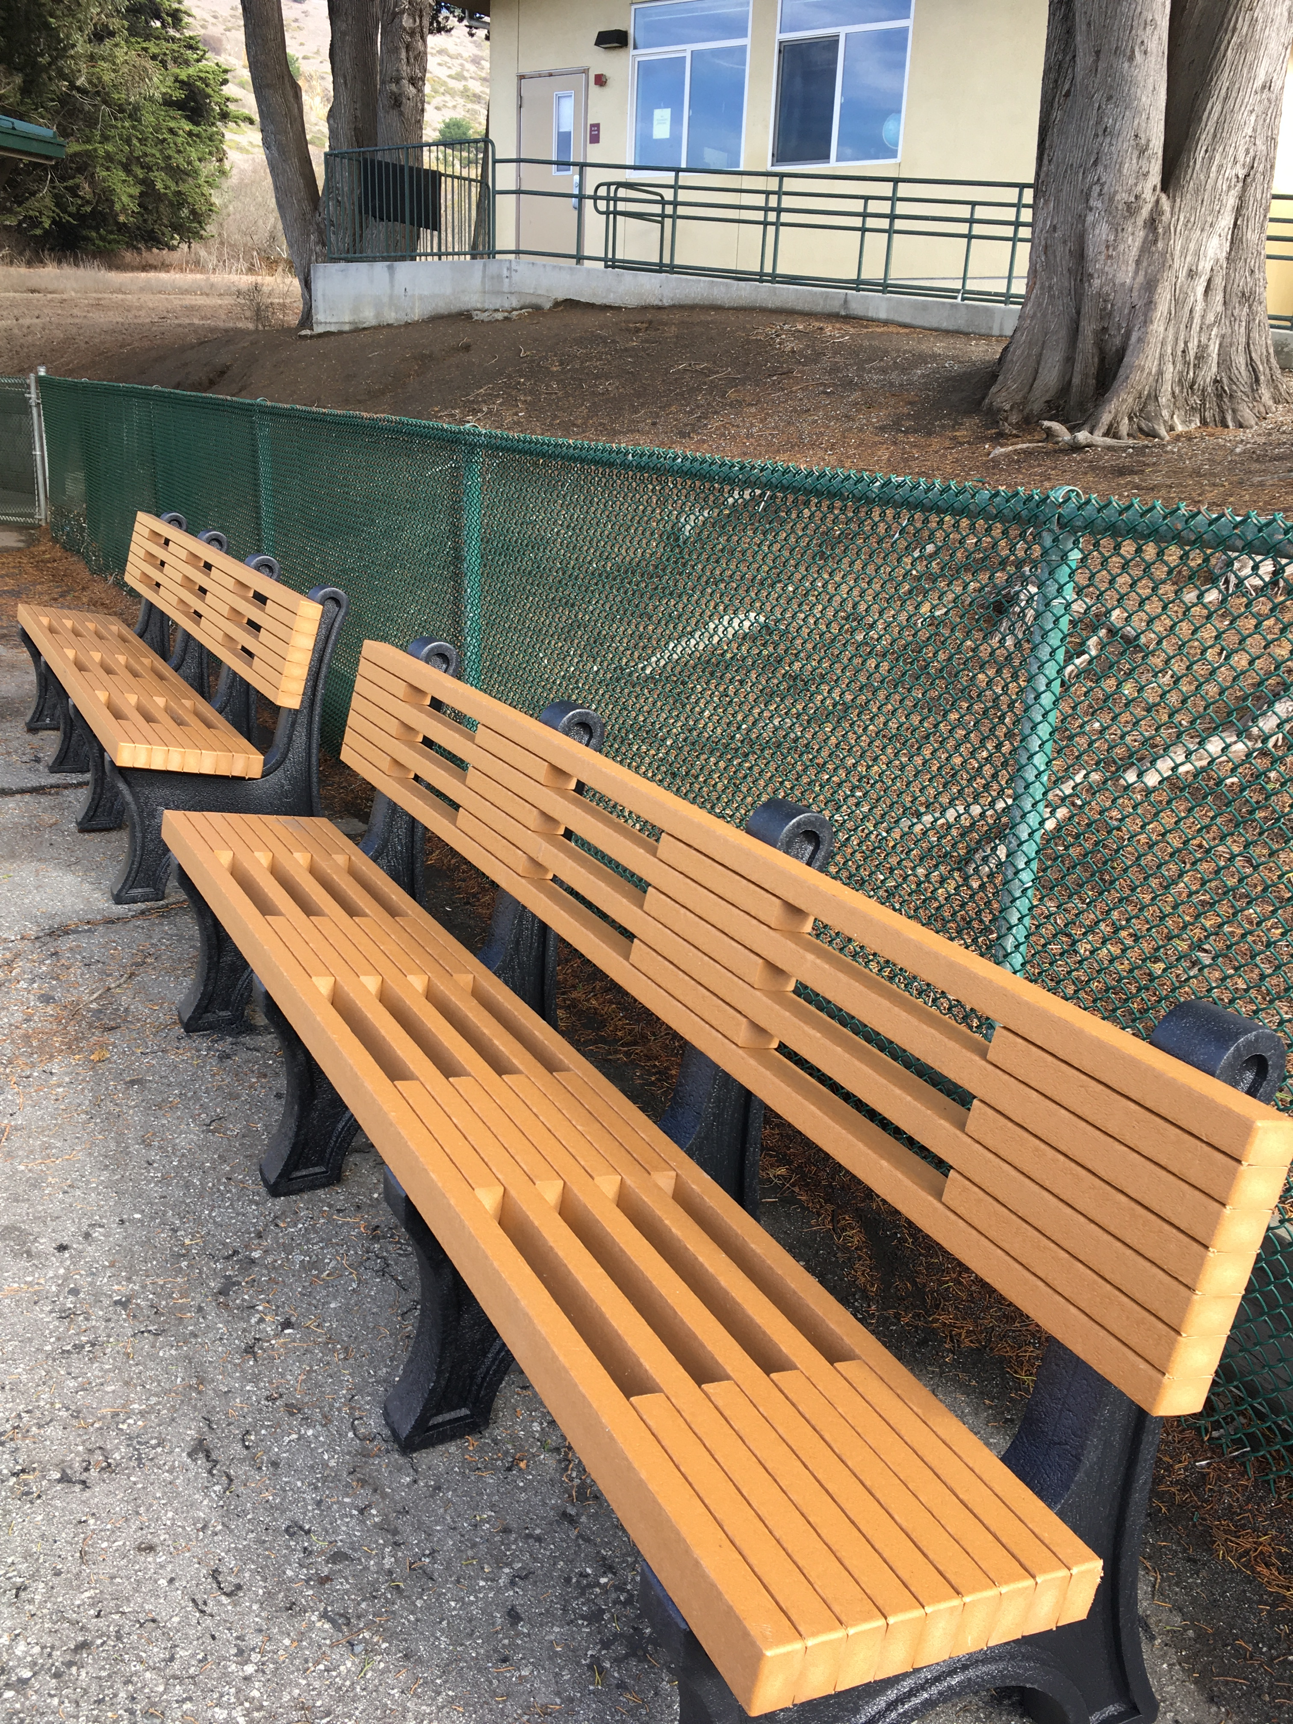
CABRILLO

Slide 12
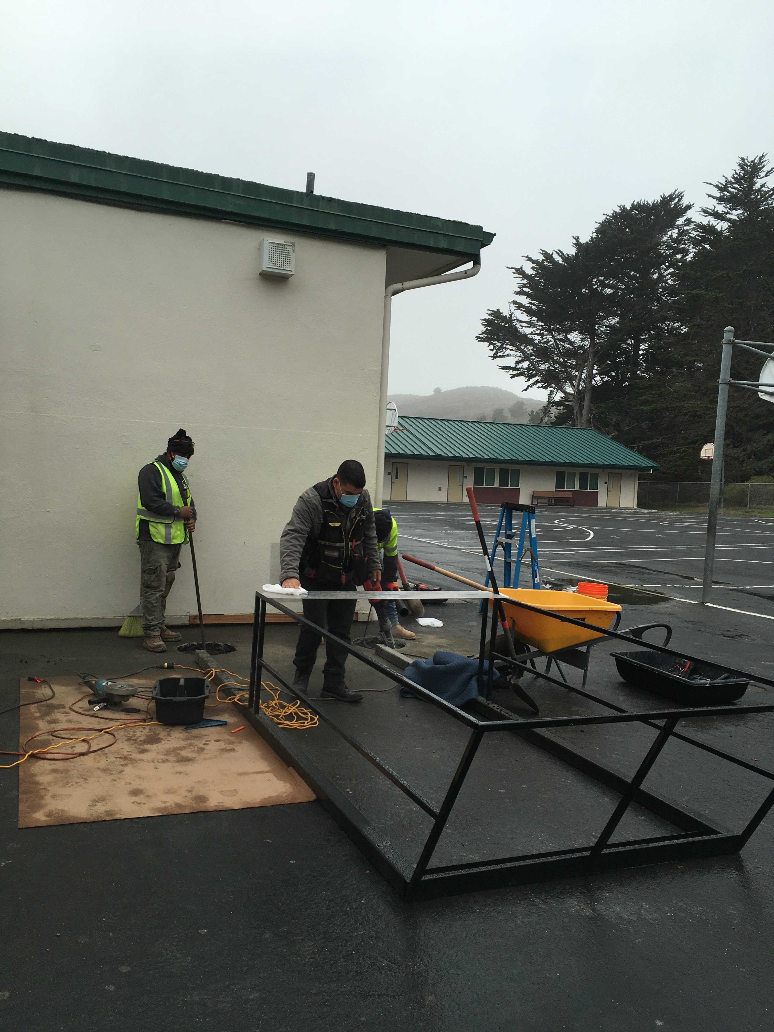
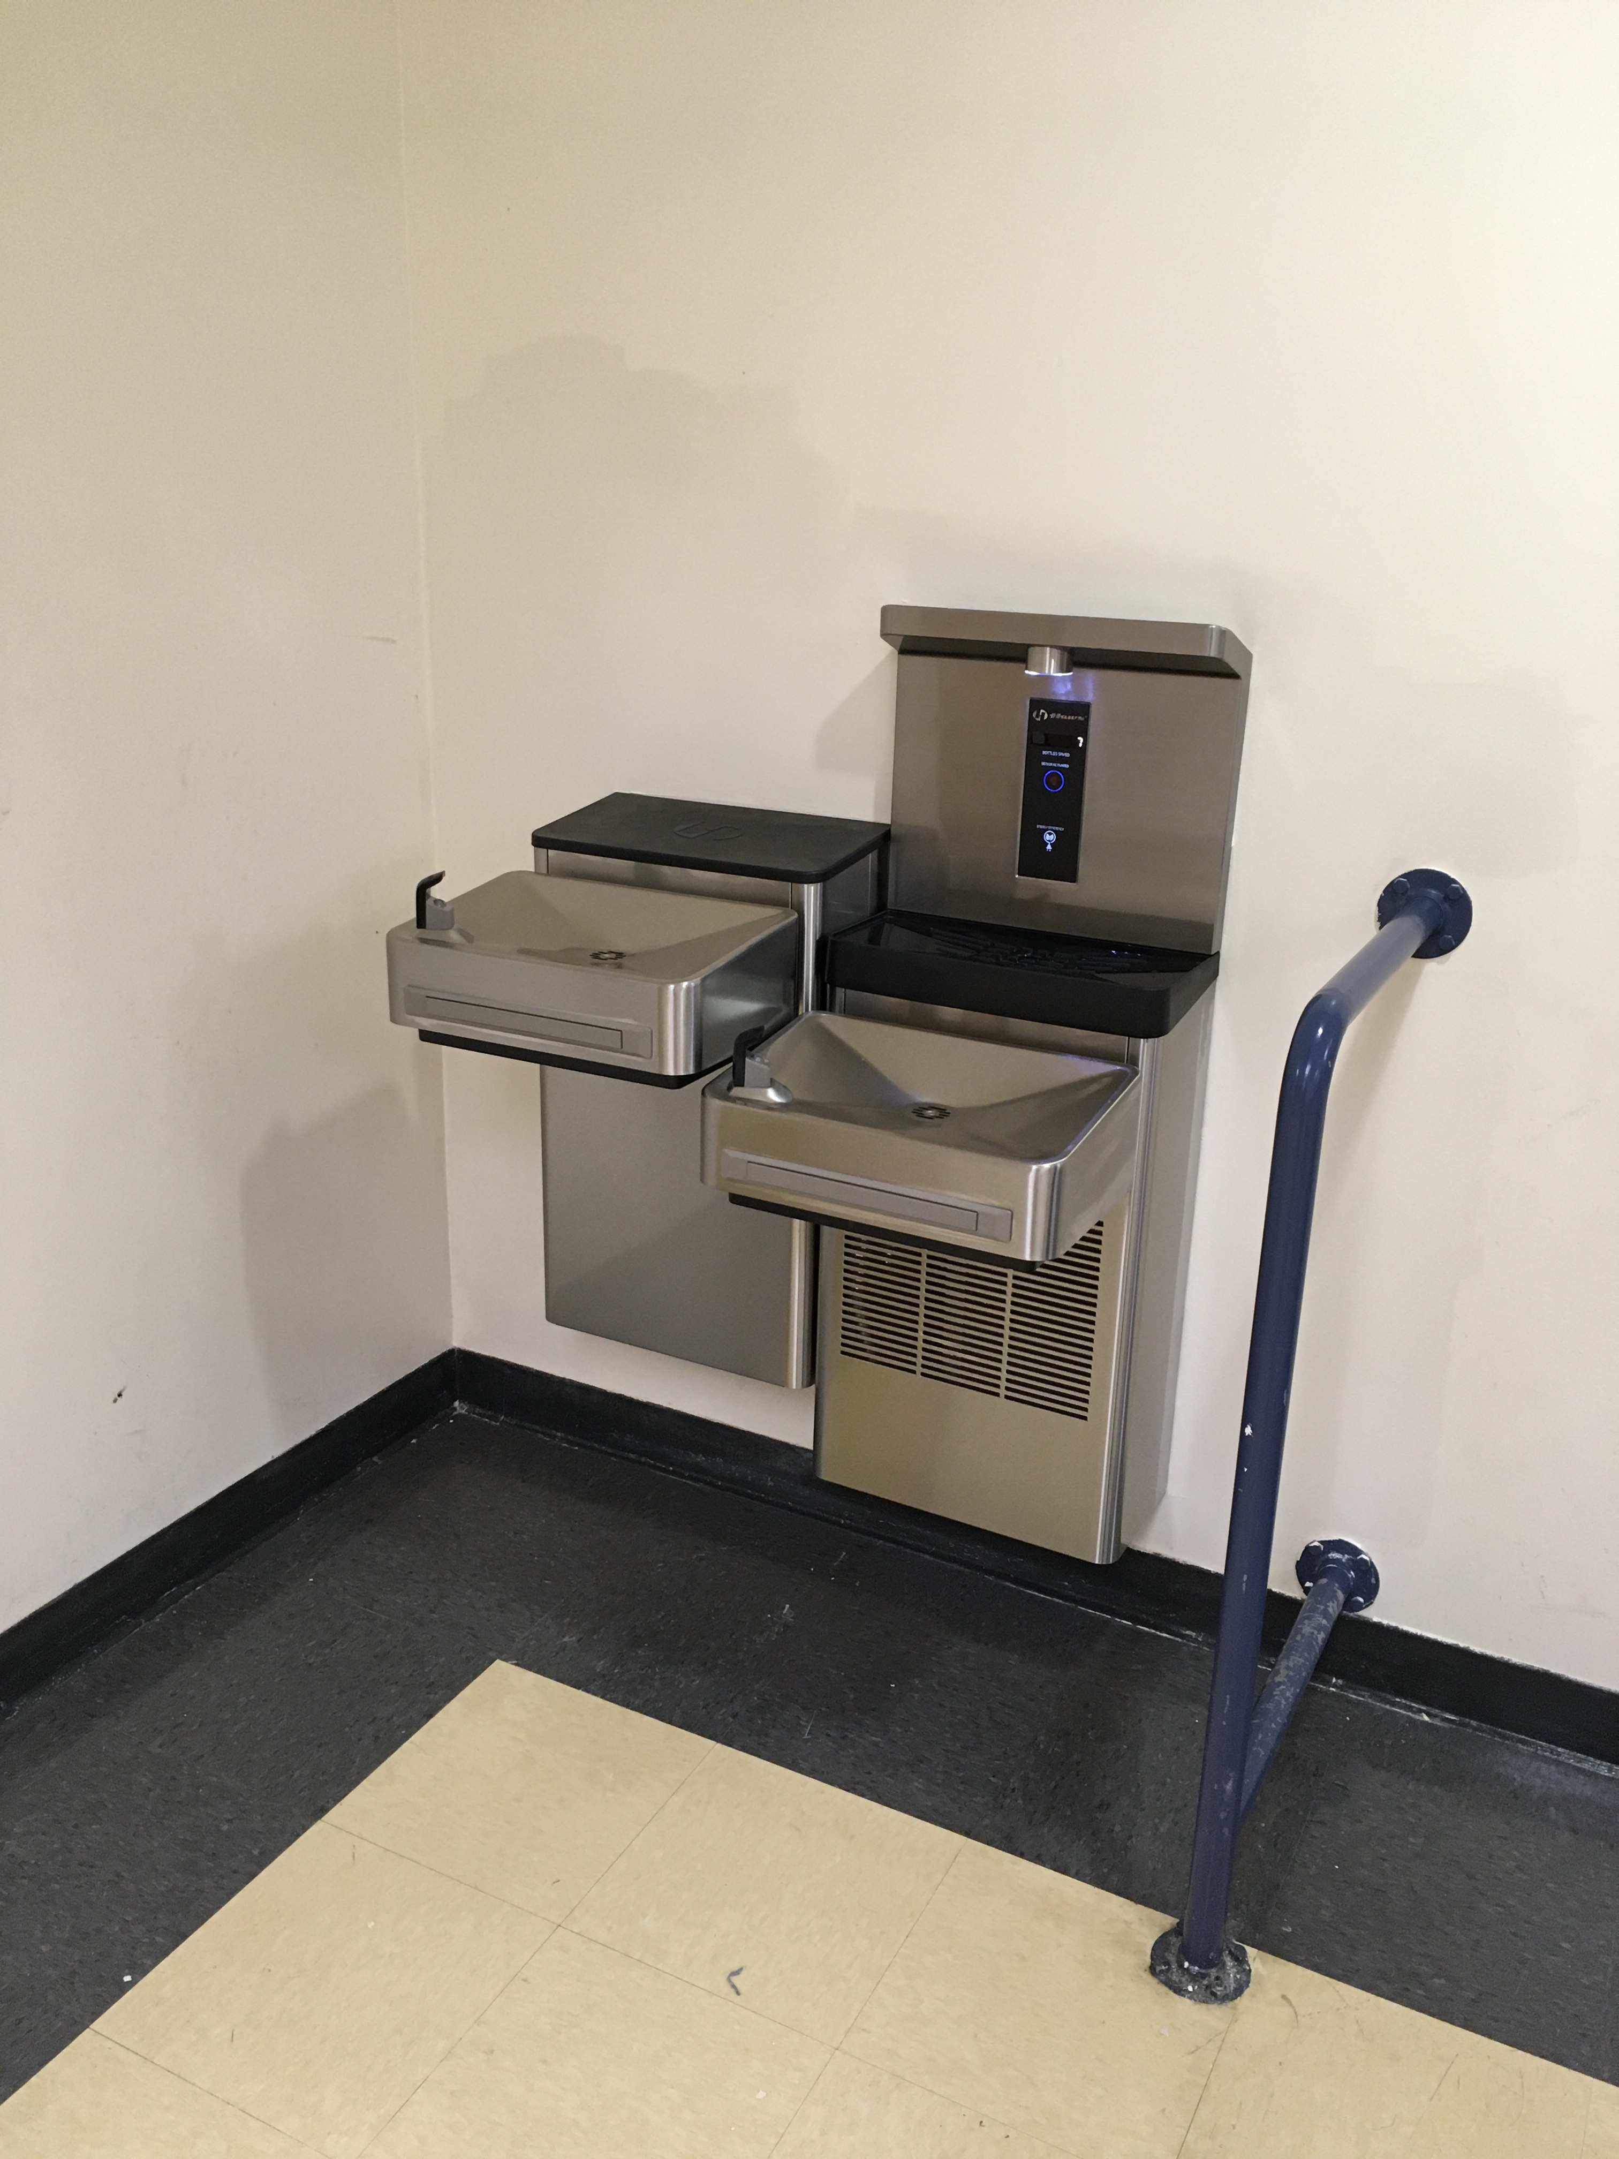
DRINKING FOUNTAIN ENCLOSURE
NEW DRINKING FOUNTAIN

Slide 13
Budget vs Current spending
Drinking Fountain Budget: $267,168
Spent: $153,297
Ortega and Vallemar used PTA funds installing drinking fountain that reduced the number of new fountains by 2. LMEC also reduced one fountain.
2. Outdoor Furniture Budget: $188,760
Spent: $108,562
3. LMEC has an overhead of $765,219 project cost as the fire alarm project was not part of the original master plan and was a requirement of local fire marshal in order for tenant occupancy of B and C wings. The requirement came after the master plan was approved by the board.

Slide 14
Budget vs Current spending
4. District Main Office Roof Budget: $163,625
Spent: $199,087
5. Ocean Shore Roof Budget: $156,200
Spent: $19,290
6. Sunset Ridge Floor replacement Budget: $8,237
Spent: $35,029
7. Cabrillo Band Room Restoration Budget: $ 0
Spent: $ 12,163

Slide 15
Budget vs Current spending
9. Sunset Ridge Classroom Flexible Furniture Budget: $304,500
Spent: $29,430

Slide 16
Our Current Tasks
We are currently reviewing Architect’s submitted Statement of Qualifications. The architect selection process is in progress. We will identify a short list base on submitted qualifications, and then conduct interviews to select the final four architects. We are anticipating board approval of the pool of architects in March and proceed with the design of major projects in April.
We are developing a project master schedule, so each project on the bond project list will have an anticipated start and finish date. We are working with the school sites on the ranking of priorities of all bond projects.

Slide 17
Our Current Tasks
3. We are working with King Consulting on applying for State matching funds for our construction projects. As the timing of the application affects our eligibility, this will need to coordinate with our project schedule.
4. After the next priority is identify during the master schedule work, roll it out. One priority we have identified is roof replacement. We are working with the Garland company, inspecting the roof and develop project scope.
5. Roll out the projects according to the master schedule.

Slide 18
Projects status: Technology
Technology
Network Infrastructure Equipment Upgrade - ($389K District/$247K E-rate Funds): Completed
Configuration/Installation of Network Infrastructure Equipment Upgrade (approx $60K): Completed
33 Classroom Projector/LCD Displays ($109K): Completed
2,300 Chromebooks (approx $789K): Completed
Teacher Laptops for IBL and Vallemar ($59K)
Bid Management Contractor for large infrastructure upgrade: Digital Advisors ($271K): ongoing.
Next Steps
Organize and begin the bid process for different aspects of technology infrastructure upgrade

